Slide 1
The PIC microcontroller
PIC18F4520: MPLAB-X IDE session

Slide 2
Ide concept

Slide 3
Programming: IDE concept
IDE
Stands for Integrated Development Environment
Integrated
All components in a single place – 1-window access
Code editors, Compilers, Assemblers, Linkers, CPU Views, Debuggers
Development
1-window usage for all processes
Project formation, Team collaboration, Program management
Code writing, Compilation to executable, Interactive debugging
Environment
1-window accessibility to functions

Slide 4
Programming: Journey of code to exe
Assembly project
C project
Extra step!
Assembler
Accepts “assembly code”
Creates “object code”
Librarian
Optional
Includes “system libraries”
Linker
Links all of it together
Produces “PIC executable”
Compiler
Accepts “C code”
Creates “assembly code”
Assembler
Accepts “assembly code”
Creates “object code”
Librarian
Optional
Includes “system libraries”
Linker
Links all of it together
Produces PIC executable

Slide 5
MPLABX IDE

Slide 6
PIC18F: MPLABX v1.85 IDE
IDE for 8-bit (and a lot many other) MCUs / CPUs / …
Microchip native offering
Newer family of IDE
Supersedes older MPLAB family
Version we will use:
MPLABX v1.85
Windows Installer is ~328MB
Works on Windows 7, 8, 10
Versions available for Linux and Mac OS as well
Prime components
MPASM (Assembler) comes free
XC8 (C Compiler) free version (restricted), paid version (optimized)

Slide 7
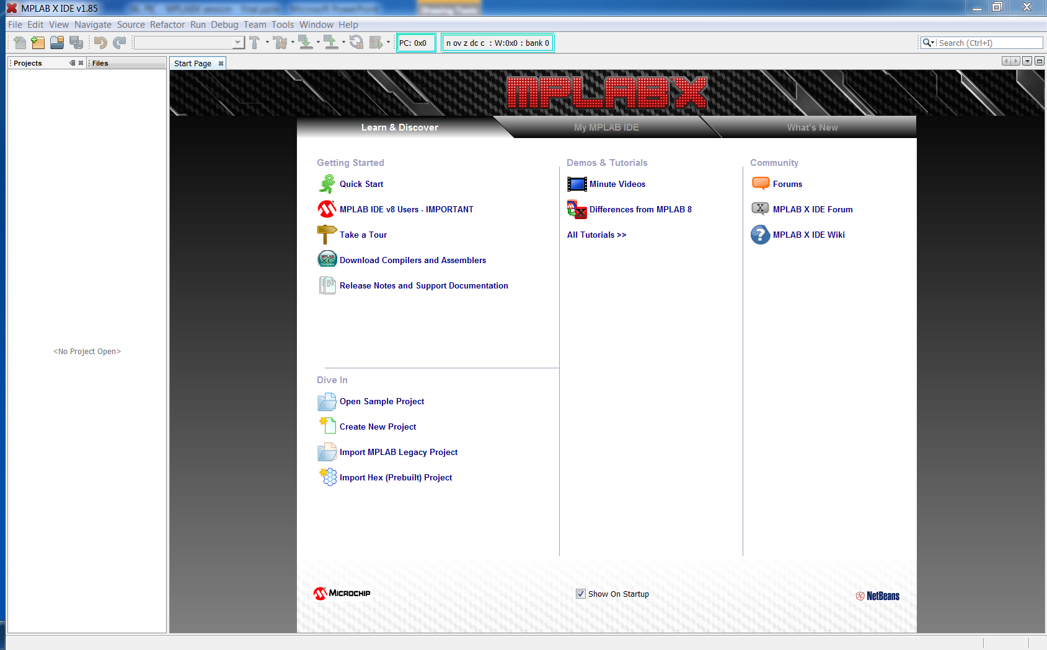
PIC18F: MPLABX – welcome screen

Slide 8
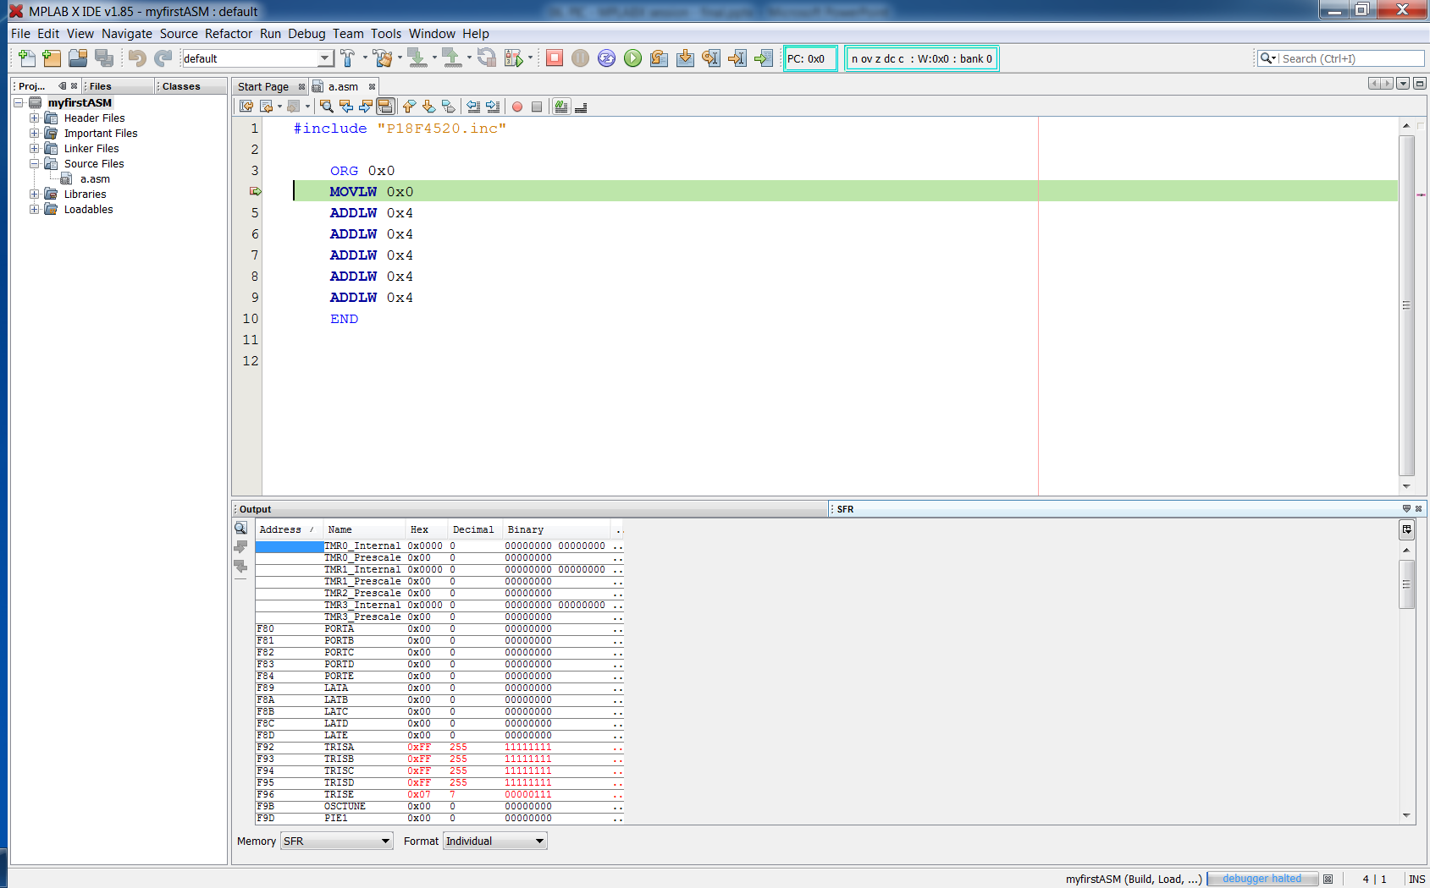
PIC18F: MPLAB in action - debugging

Slide 9
PIC18F: MPLABX – Project development
Detailed sessions will be taken online
Windows installation of IDE
Project Creation
Code development (mpasm)
Debugging session using MPLAB Simulator
Screen video captures will be shared with the audience

Slide 10
PIC18F: MPLABX ‘windows’
Project Explorer
Code Editor
Project compilation options
mpasm – MPLAB Assembler project
Build, make, clean, etc
Debugging setup
MPLAB Simulator
Reset, single-step, run, halt, breakpoints, etc
View windows – important ones
SFRs, File registers
Status register
Program memory, PC
Disassembly listing

Slide 11
Thank you!

